Slide 1
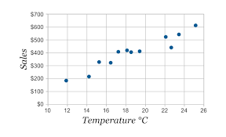
Scatter Plot
A scatter plot is a diagram where each value in the data set is represented by a dot.
Scatter plots also called scatter graphs or scatter chart.
A line graph uses a line on an X-Y axis to plot a continuous function, while a scatter plot uses dots to represent individual pieces of data.
In statistics, these plots are useful to see how variables are related to each other.
For example, a scatter chart can suggest a
linear relationship (i.e. a straight line in 2D.)
Example - A scatter plot of Sales of Soft drinks
vs Temperature.
We can take inference that sales goes high on a
Hot day.

Slide 2
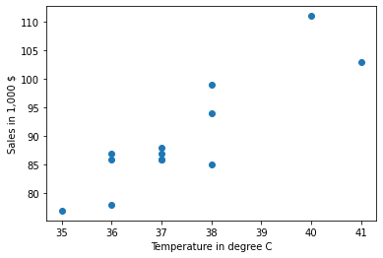
Plotting Scatter plot using matplotlib
Let’s plot a 2D scatter plot.(i.e. We have 2 variables in total)
Let x = [38,36,36,37,40,37,41,37,38,36,35,38,37] represents temperature of a day.
y = [99,86,87,88,111,86,103,87,94,78,77,85,86] represents 1,000$ sales on that day.
>>> import matplotlib.pyplot as plt
y = [99,86,87,88,111,86,103,87,94,78,77,85,86]
x = [38,36,36,37,40,37,41,37,38,36,35,38,37]
plt.scatter(x,y)
plt.xlabel('Temperature in degree C')
plt.ylabel('Sales in 1,000 $')
We can infer that on a hot day sales goes up!

Slide 3
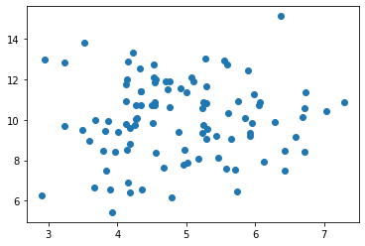
Scatter plot of random 100 points
import numpy
import matplotlib.pyplot as plt
x = numpy.random.normal(5.0, 1.0, 100)
y = numpy.random.normal(10.0, 2.0, 100)
plt.scatter(x, y)
plt.show()

Slide 4
References worth looking
https://www.w3schools.com/python/matplotlib_scatter.asp
https://matplotlib.org/stable/api/_as_gen/matplotlib.pyplot.scatter.html
https://www.machinelearningplus.com/plots/python-scatter-plot/

